Slide 1
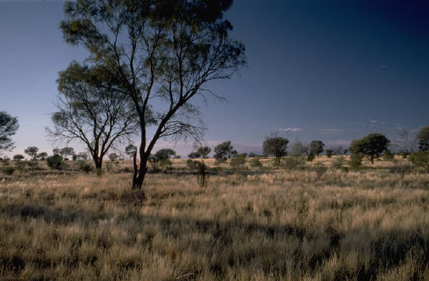
Grassland Biome
Kristin HooSang
Babafemi Ojubanire
Mariama Spence

Slide 2
Grassland
Grasslands are areas where the vegetation is dominated by grass and plants.
Grasslands are everywhere except Antarctica.
Grassland vegetation can vary in height from very short to quite tall.
Average temperatures range between -4 and 86 degrees Fahrenheit.

Slide 3
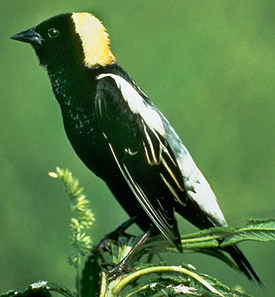
Bobolink
The bobolink is our first animal.
They migrate in flocks to Argentina, Bolivia, and Paraguay.
Each fall Bobolink’s gather in large numbers in South America rice fields where they eat rice. They are known as ricebirds in these areas.
Female bobolinks lay 5 to 6 eggs.

Slide 4
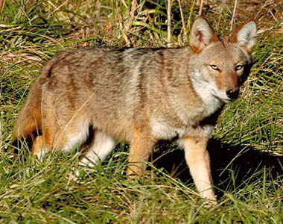
Coyote
The coyote is mostly found in North America.
They are very clever and can adapt to changing landscapes easily.
These animals will eat almost anything. They hunt rabbits, rodents, fish, frogs, and even deer. They also happily dine on insects, snakes, fruit, and grass.
They have a keen sight and sense of smell and they travel and hunt in packs.

Slide 5
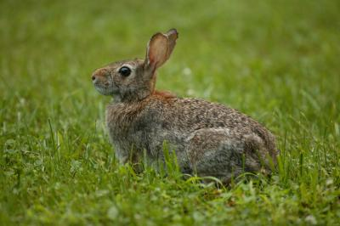
Eastern Cottontail
Eastern cottontails can be found in meadows and shrubby areas in the eastern and south-central United States, southern Canada, eastern Mexico and, Central America.
There habitats include open grassy area, clearings, and old fields. They typically eastern cottontails occupy habitats in and around farms including fields, pastures, open woods, thickets associated with fencerows, wooded thickets, forest edges, and suburban areas. They are also found in swamps and marshes and usually avoid dense woods. They are rarely found in woods.

Slide 6
Animals
Our animals will be given a reservation of land that they can peacefully live on.
We will make sure they don’t get out to harm people by building a brick wall around the whole reservation.
There will also be a gate if you want to go in with a tour guide to see the animals.

Slide 7
Community
We have an eco-friendly community, which will include:
Recycle Bins
Solar Panel Windows
Wind Turbines
Compact Florescent Light Bulbs- (which save energy)
A Hydroelectric Plant- (to create energy and clean the water)

Slide 8
Apartment Layout
Green- Hallway
Orange- Elevator
Blue- Bathroom
Yellow- Kitchen
Purple- Bedroom
Beige- Stairs
Shaded- Living Room/Den/Hallway

Slide 9
Town Layout

Slide 10
Apartment Homes
We are able to fit 66 families in our apartment.
The cost of rent is: $300
Each home in the apartment will have:
Two bedrooms
1.5 bathroom
Kitchen
Living Room or Den- (whichever you choose)

Slide 11
Jobs
We will also provide jobs for the incoming families if they don’t have one already.
You can work at our local grocery store as a cashier, manager, or a sales clerk.
If you are handy, an engineer, or a mathematician you can also work at the Hydroelectric Power Plant.

Slide 12
Entertainment
We will have a community park in which children and adults alike can play.
You can also make stands and sell lemonade whatever you wish.

Slide 13
Budget
Wood- $620400
Cement- $46433.20
Bricks- $261080.82
Glass- $60257.76
Generator- $1399
Solar Panels- $1996
Doubled Doors- $14128
Park Benches- $512
Total Cost- $1006206.78

